Slide 1
Day21 : Advance Java - 102
- Utkarsh Sandeep Singh

Slide 2
Map

Slide 3
Table of Contents
Definition and Declaration
Example
Classes which implement Map
Some Important Methods
Map.Entry Interface

Slide 4
Definition of Map
A map contains values on the basis of key, i.e. key and value pair. Each key and value pair is known as an entry. A Map contains unique keys.
A Map is useful if you have to search, update or delete elements on the basis of a key.
A Map doesn't allow duplicate keys, but you can have duplicate values. HashMap and LinkedHashMap allow null keys and values, but TreeMap doesn't allow any null key or value.
A Map can't be traversed, so you need to convert it into Set using keySet() or entrySet() method.

Slide 5
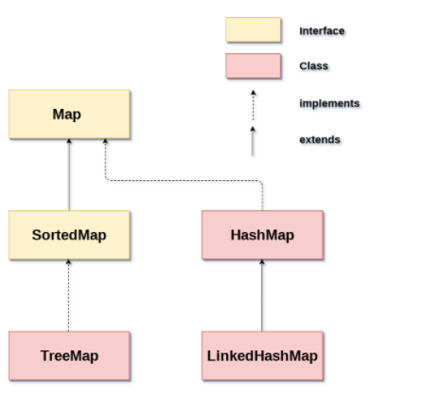

Slide 6
HashMap
Java HashMap contains values based on the key.
Java HashMap contains only unique keys.
Java HashMap may have one null key and multiple null values.
Java HashMap is non synchronized.
Java HashMap maintains no order.
The initial default capacity of Java HashMap class is 16 with a load factor of 0.75.

Slide 7
LinkedHash Map
Java LinkedHashMap contains values based on the key.
Java LinkedHashMap contains unique elements.
Java LinkedHashMap may have one null key and multiple null values.
Java LinkedHashMap is non synchronized.
Java LinkedHashMap maintains insertion order.
The initial default capacity of Java HashMap class is 16 with a load factor of 0.75.

Slide 8
TreeMap
Java TreeMap contains values based on the key.
Java TreeMap contains only unique elements.
Java TreeMap cannot have a null key but can have multiple null values.
Java TreeMap is non synchronized.
Java TreeMap maintains ascending order.

Slide 9
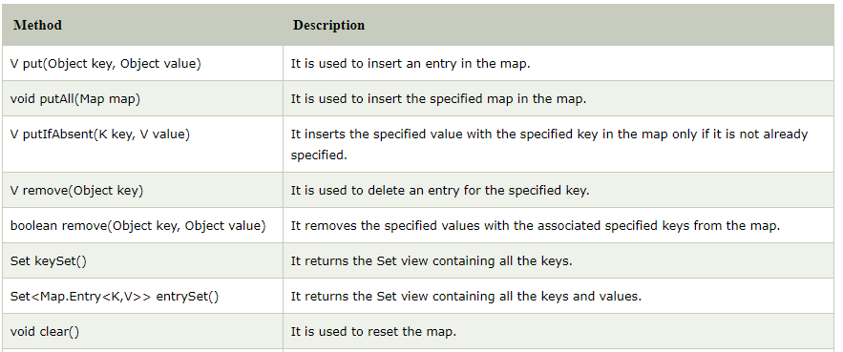
Methods

Slide 10
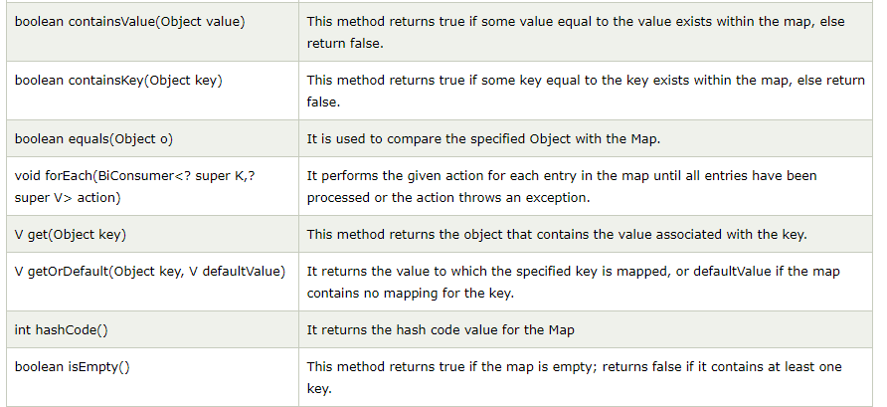

Slide 11
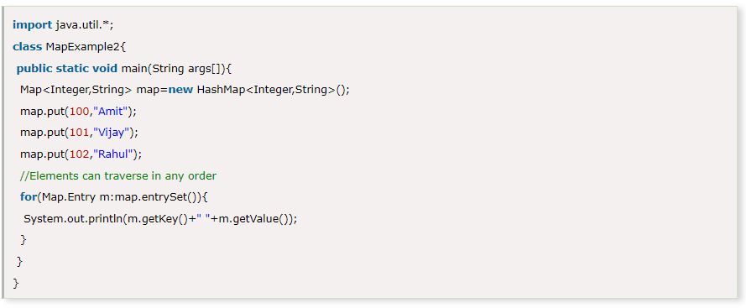
Map.Entry Interface
Entry is the subinterface of Map. So we will be accessed it by Map.Entry name. It returns a collection-view of the map, whose elements are of this class. It provides methods to get key and value.

Slide 12
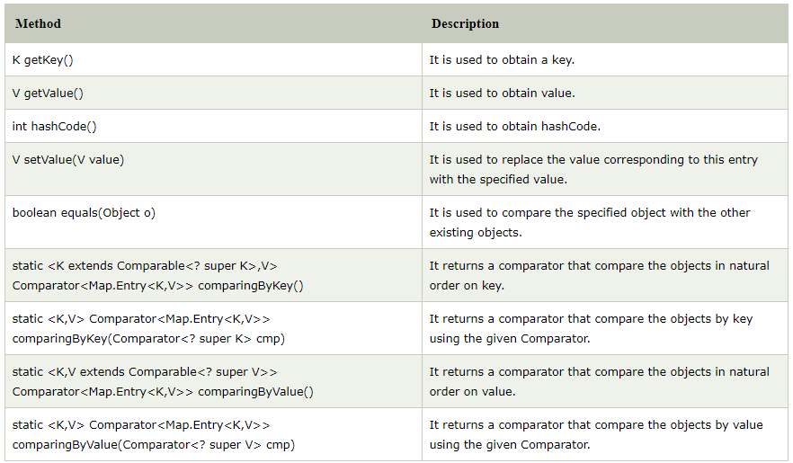

Slide 13
Queries

Slide 14
Thank you

